Slide 1
Fitting time series models
Syndromic Surveillance Training – Day 2

Slide 2
Review of Yesterday
Answer the following questions in your groups
What is syndromic surveillance?
How are indicators relevant?
What indicators are used for COVID-19? mPox? Lassa fever?
Any questions from yesterday?

Slide 3
Goals of this course - today
The specific objectives are:
To identify indicators most relevant for these purposes.
To describe and interpret the models used to a) establish a baseline; b) assess higher or lower levels than expected during the pandemic.
To understand the data processing pipeline - from receipt of indicator data to production of figures.
To interpret results from the various visualizations of the data and results.
To be able to implement the data cleaning, modeling and visualization process in R.

Slide 4
Teaching Objectives
Describe time series modeling
Learn about key strategies
Plotting
Time trends
Seasonality
Discuss two examples

Slide 5
What is a time series?

Slide 6
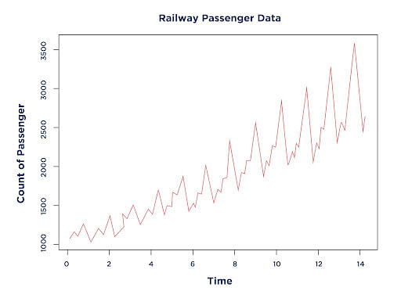
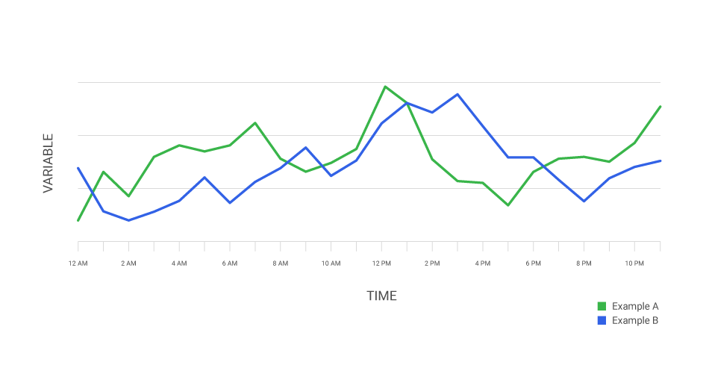
What is a time series?

Slide 7
Steps we will cover
Setup data
Visually inspect the data
Perform preliminary analysis
Check for and address autocorrelation
Run the final model and plot the results

Slide 8
Step 1: Setup Data

Slide 9
Data Setup
One data row for each time period, including:
Time variable for day/month/year
Outcome of interest at that time period
Possible variables:
Time Trend
Post-intervention Level Change
Post-intervention Trend Change
Outcome of interest
Notes:
Doing the basic setup for population-level data. Can also use individual data with a similar set of variables (1 line for each observation at each time period)
While you can do this in R, it’s easier in Excel

Slide 10
Month | Visits
2016-01-01 | 557
2016-02-01 | 574
2016-03-01 | 542
2016-04-01 | 793
2016-05-01 | 605
2016-06-01 | 612
2016-07-01 | 685
2016-08-01 | 466
2016-09-01 | 554
2016-10-01 | 698
… | …
Notes:
Average monthly water flow over the year in cubic metres per second

Slide 11
Step 2: Visually Inspect Data

Slide 12
Visually Inspect Data
What you are looking for:
Trends
Linear
Polynomial
Exponential
Seasonal
Potential interventions
Data quality issues
Missing data
“Wild” points

Slide 13
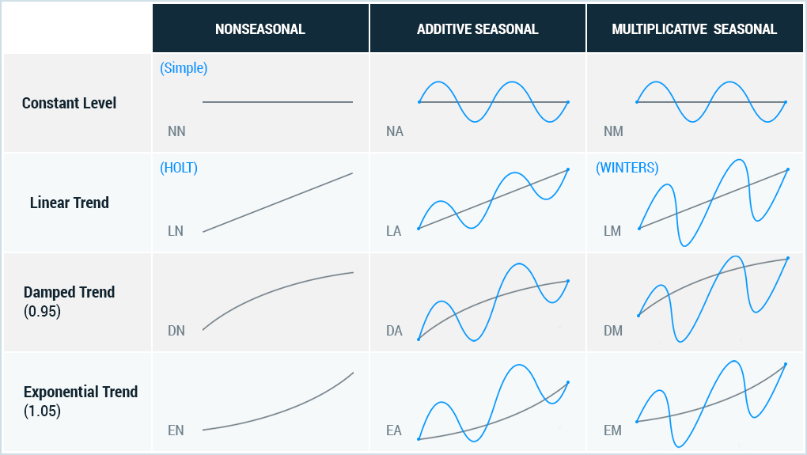

Slide 14
What trends do we see here?
Notes:
Measured water flow in 10^8 cubic metres
Point near 1913 was a recognized drought year

Slide 15
Step 3: Preliminary Analysis

Slide 16
Where we are now
Setup data
Visually inspect the data
Preliminary analysis
Check for and address autocorrelation
Run the final model and plot the results

Slide 17
Preliminary analysis
Run a standard OLS regression with a time series specification
We will work through:
Intercept-only
Simple time trend
Quadratic time trend
This will form the basis for checks about autocorrelation

Slide 18
Intercept-only Model
outcome_{t} =β₀+ε_{t}
Notes:
B0: expected outcome at first time point
B1: pre-existing trend in the outcome of interest
B2: immediate change in the level of the outcome after the intervention (first var of interest)
B3: change in the trend of the outcome following intervention (second var of interest)

Slide 19
# Run a linear model with only an intercept term
ols.model <- lm(count ~ 1, data=dataset)
# Different functions to work with the model
# Print a summary of the results
summary(ols.model)
# Produce confidence intervals
confint(ols.model)

Slide 20
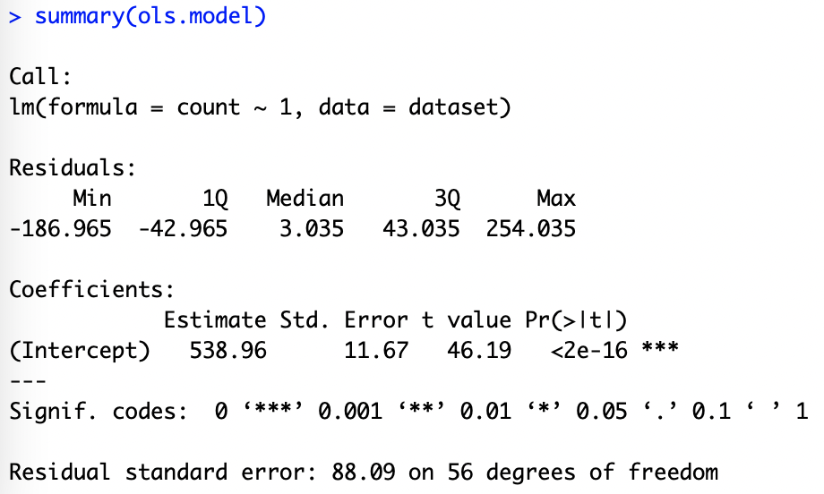

Slide 21
# Input dataset and x,y axis variables
ggplot(dataset,aes(x=time,y=count)) +
# Add points
geom_point(color="pink") +
# Add fitted line
geom_line(aes(x=time,y=ols.model$fitted.values),color="red") +
# Change figure aesthetics
xlab("Month") +
ylab("Number of Outpatient Visits") +
ylim(c(0,900)) +
theme_bw()

Slide 23
Intercept and Time Model
outcome_{t} =β₀+ε_{t}
outcome_{t} =β₀+ β₁·time+ε_{t}
Notes:
B0: expected outcome at first time point
B1: pre-existing trend in the outcome of interest
B2: immediate change in the level of the outcome after the intervention (first var of interest)
B3: change in the trend of the outcome following intervention (second var of interest)

Slide 24
# Run a linear model with an intercept term and time term
ols.model.time <- lm(count ~ time, data=dataset)
# Different functions to work with the model
# Print a summary of the results
summary(ols.model.time)
# Produce confidence intervals
confint(ols.model.time)

Slide 25
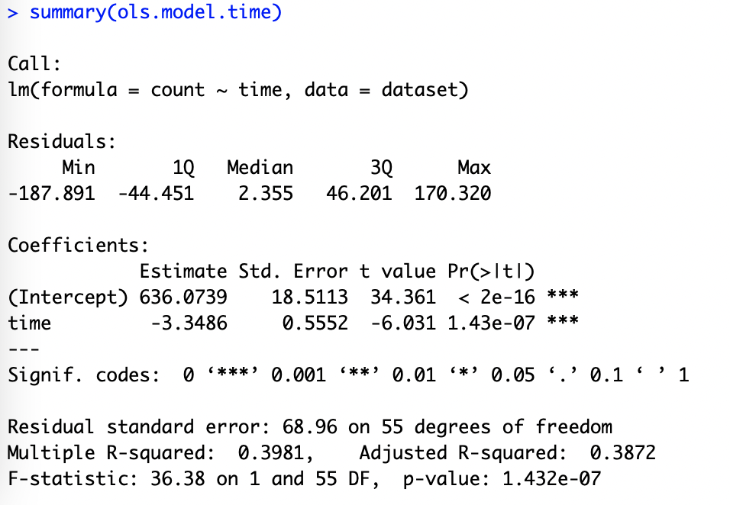

Slide 27
Intercept and Time Model
outcome_{t} =β₀+ε_{t}
outcome_{t} =β₀+ β₁·time+ε_{t}
outcome_{t} =β₀+ β₁·time+β₂·time²+ε_{t}
Notes:
B0: expected outcome at first time point
B1: pre-existing trend in the outcome of interest
B2: immediate change in the level of the outcome after the intervention (first var of interest)
B3: change in the trend of the outcome following intervention (second var of interest)

Slide 28
# Run a linear model with an intercept term and square term
ols.model.time2 <- lm(count ~ time + I(time^2), data=dataset)
# Different functions to work with the model
# Print a summary of the results
summary(ols.model.time2)
# Produce confidence intervals
confint(ols.model.time2)

Slide 29
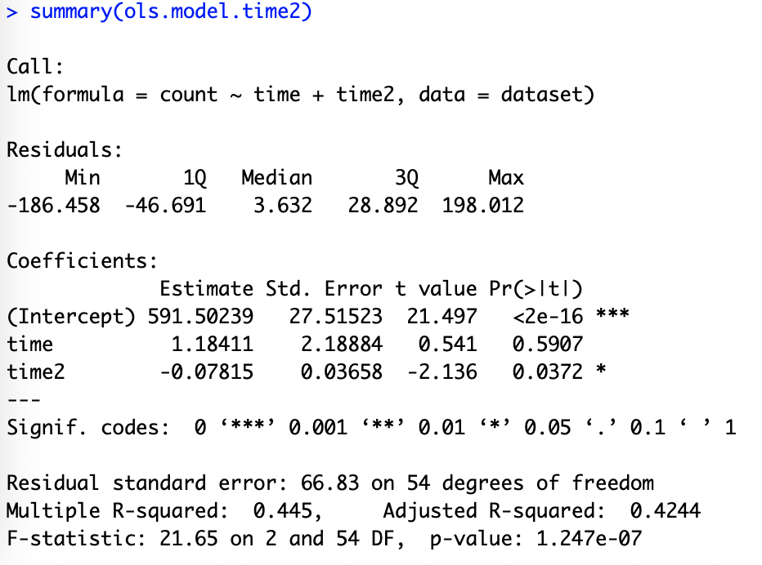

Slide 31
Seasonality and time trends

Slide 32
Time series patterns
Seasonal: Outcomes are impacted by seasonal factors (season, month, day of the week)
Fixed with known frequency
Easily mistaken with fluctuations (must be related to some aspect of calendar time)
Trend: Long-term increase or decrease in the data.
Trends can change direction over time
Trends do not need to be linear
Source: Forecasting: Principles and Practice (https://otexts.com/fpp2/)

Slide 33
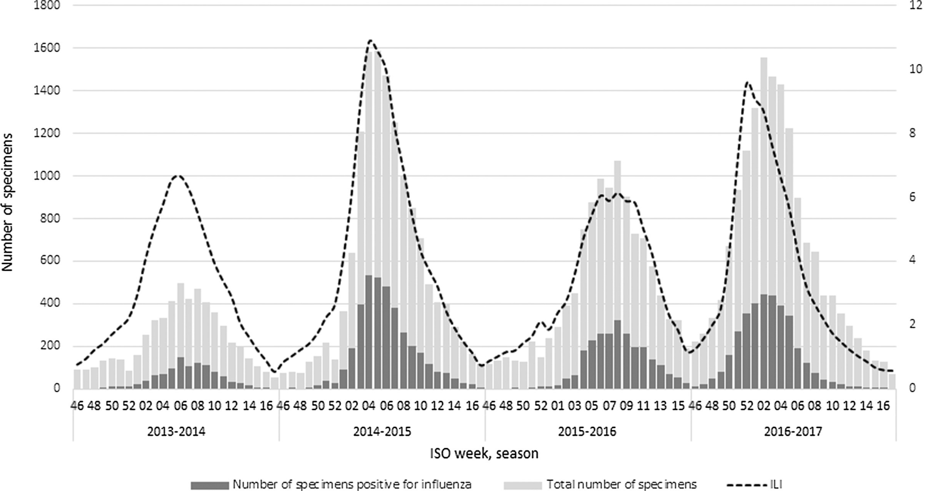
Influenza in Italy
(Rosano et al., 2019)
Notes:
End of January through March (Winter months) and decreases in the cold months.

Slide 34
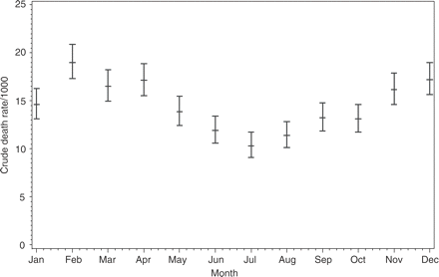
Death rates in Burkina Faso from 1993-2001
(Kynast-Wolf et al., 2005)

Slide 35
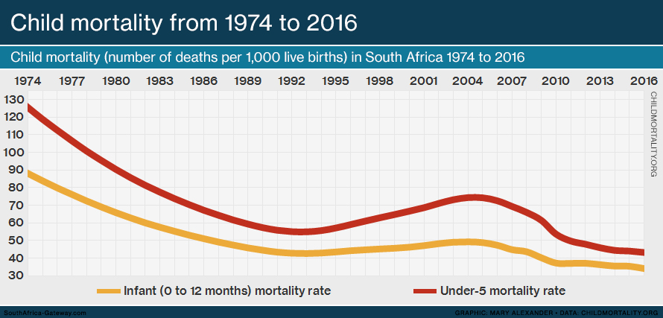
Notes:
Sometimes we will refer to a trend as “changing direction,” when it might go from an increasing trend to a decreasing trend.

Slide 36
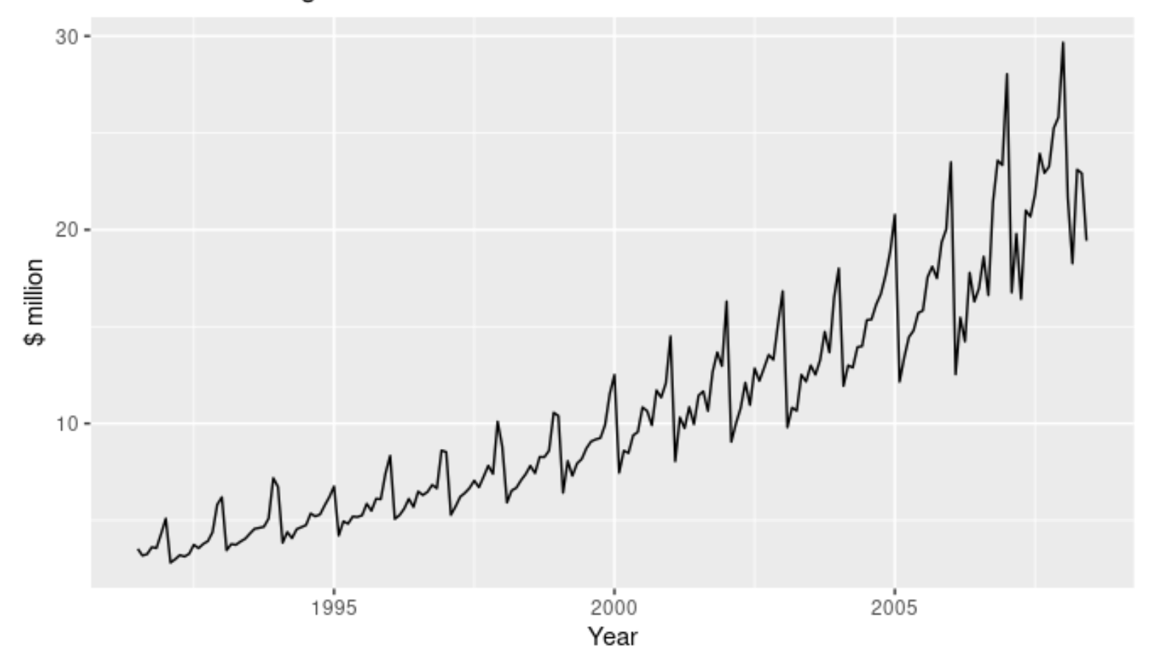
Antidiabetic drug sales in Australia
Source: Forecasting: Principles and Practice (https://otexts.com/fpp2/)
Notes:
There is also a strong seasonal pattern that increases in size as the level of the series increases. The sudden drop at the start of each year is caused by a government subsidisation scheme that makes it cost-effective for patients to stockpile drugs at the end of the calendar year.

Slide 37
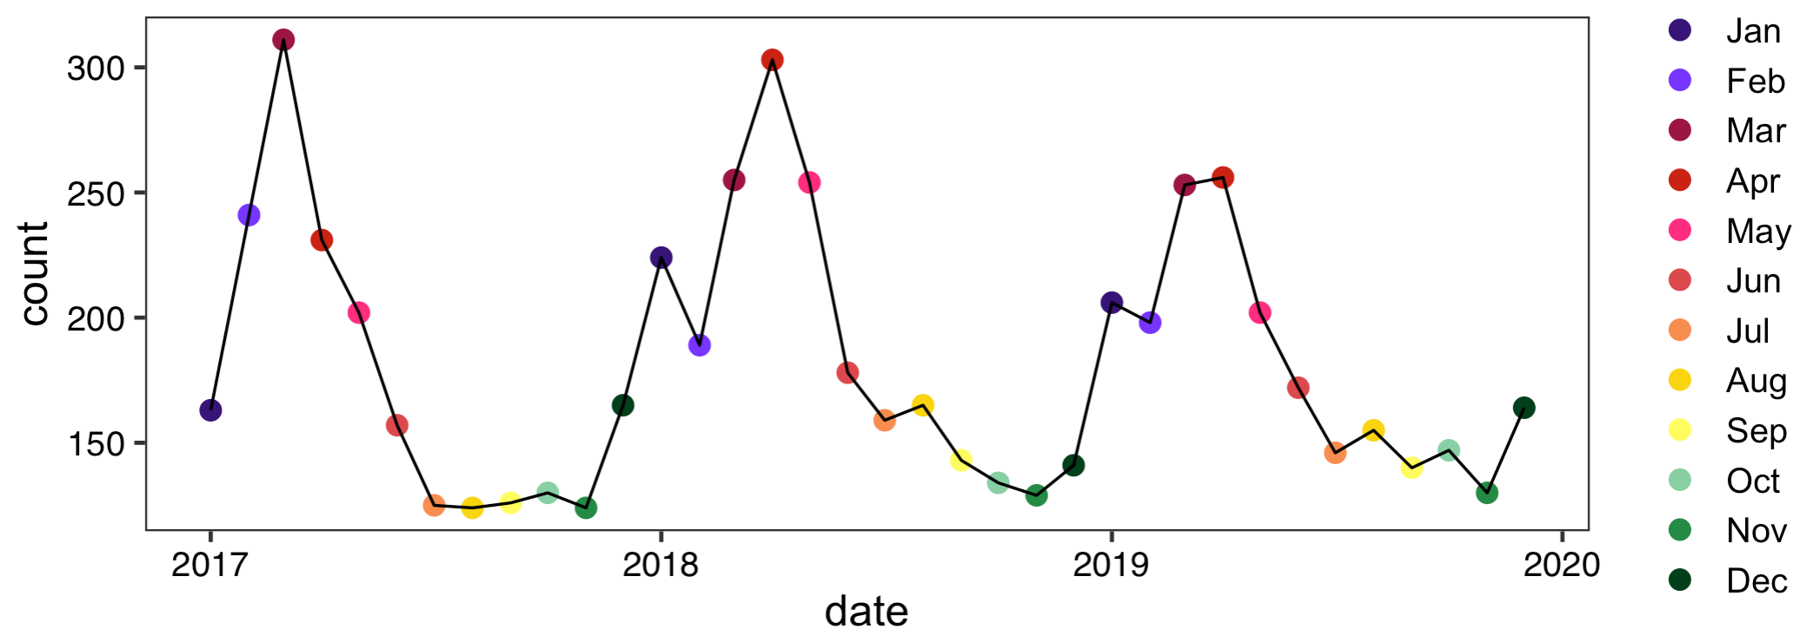
Activity: Malaria cases in Malawi facility

Slide 38
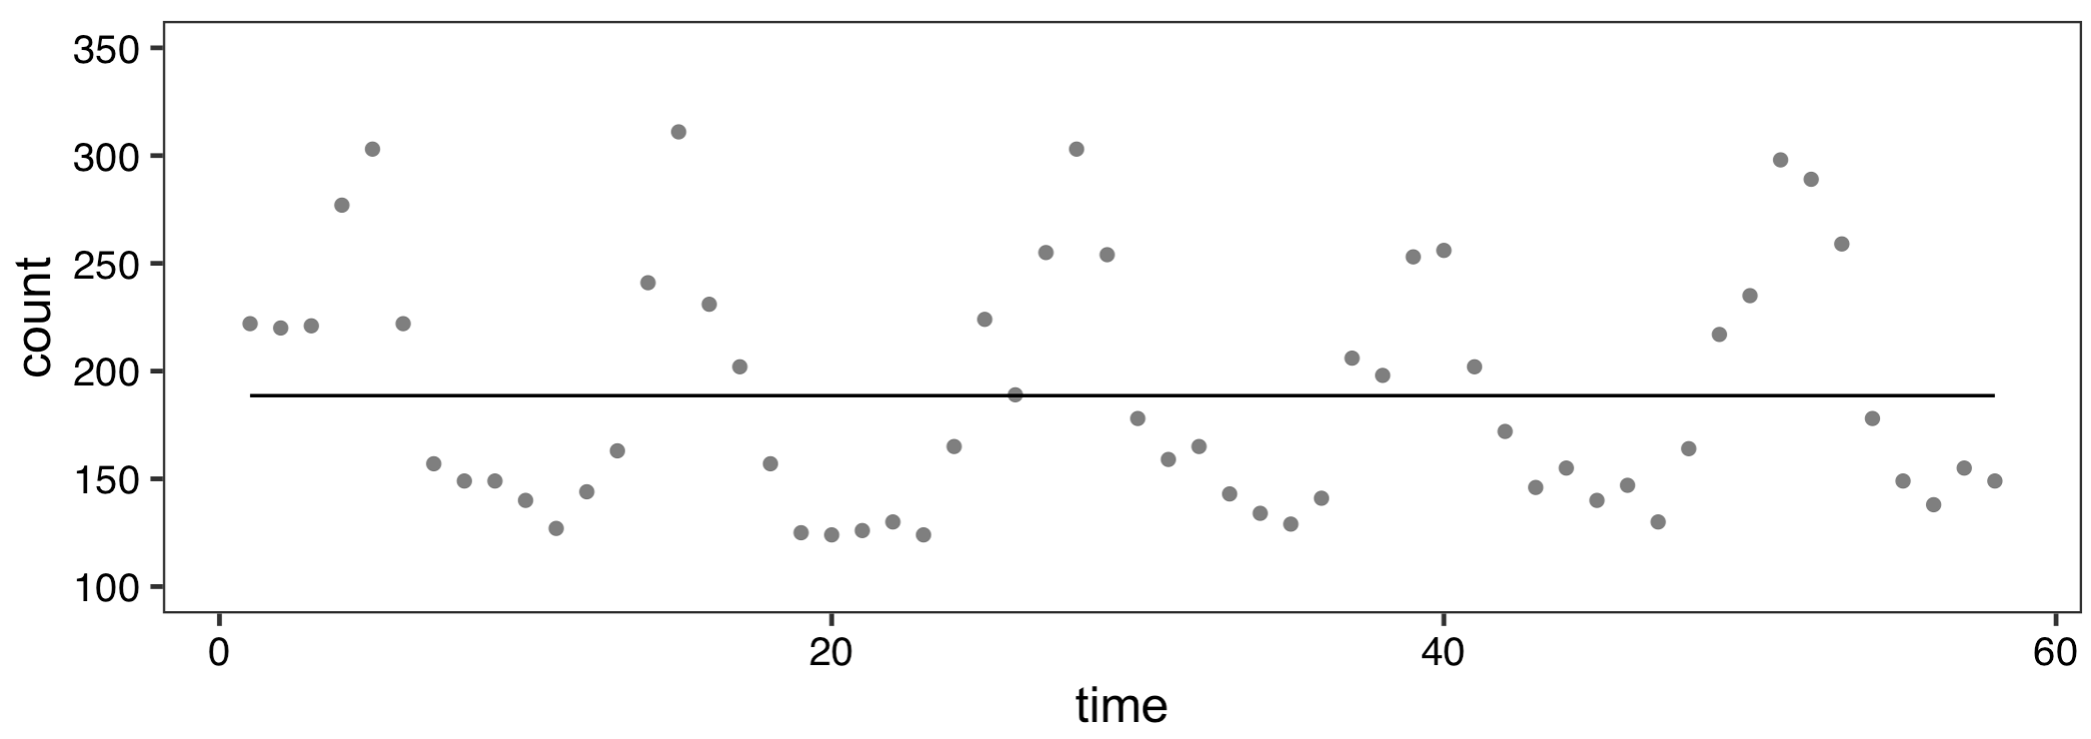
Malaria cases in Malawi facility
outcome_{t} =β₀+ε_{t}

Slide 39
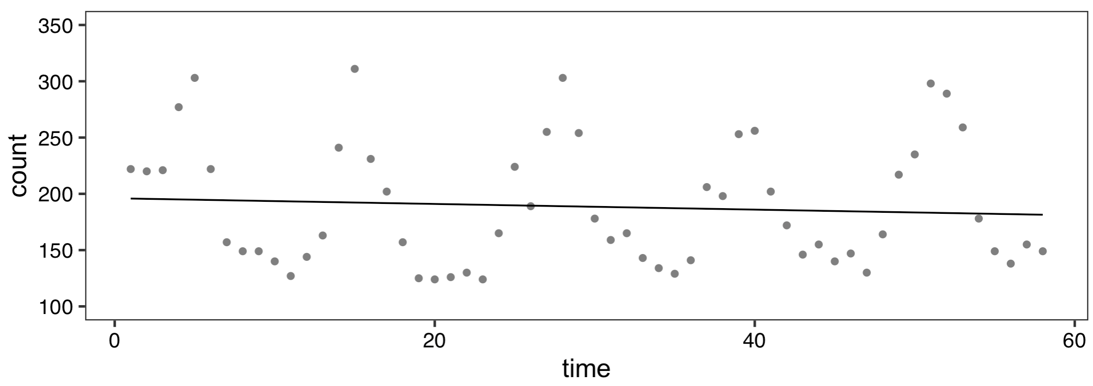
Malaria cases in Malawi facility
outcome_{t} =β₀+ β₁·time+ε_{t}

Slide 40
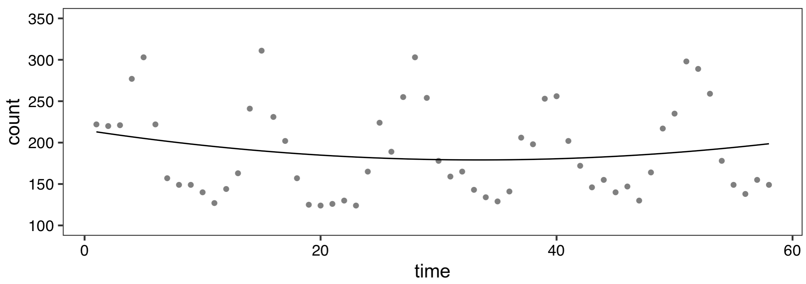
Malaria cases in Malawi facility
outcome_{t} =β₀+ β₁·time+β₂·time²+ε_{t}

Slide 41
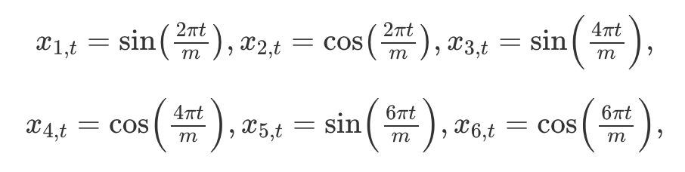
How to deal with seasonality and trend?
Seasonality: Fourier series are popular ways to deal with seasonality in time series models (other options: splines, dummy variables, etc.)
Trends: Add a linear term(s) to capture yearly trend
Will only capture linear decreases or increases over time
If changes are not linear, dummy variables or more complex transformations (log, quadratic, etc.) can be used
Source: Forecasting: Principles and Practice (https://otexts.com/fpp2/)

Slide 42
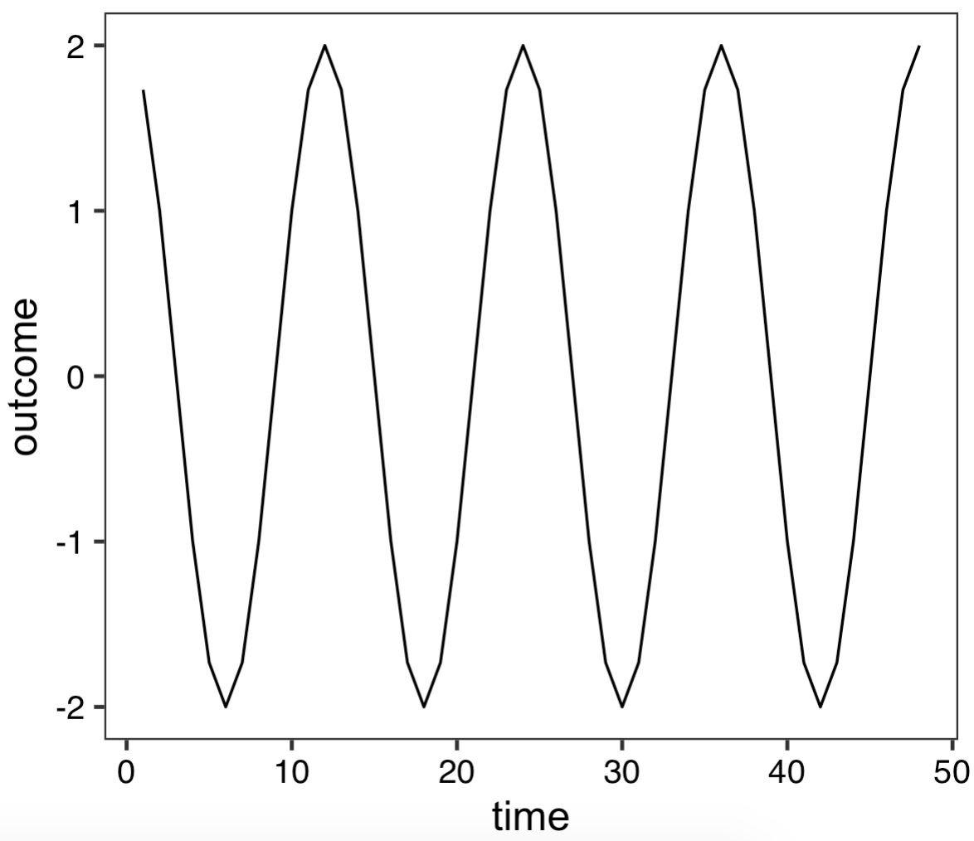
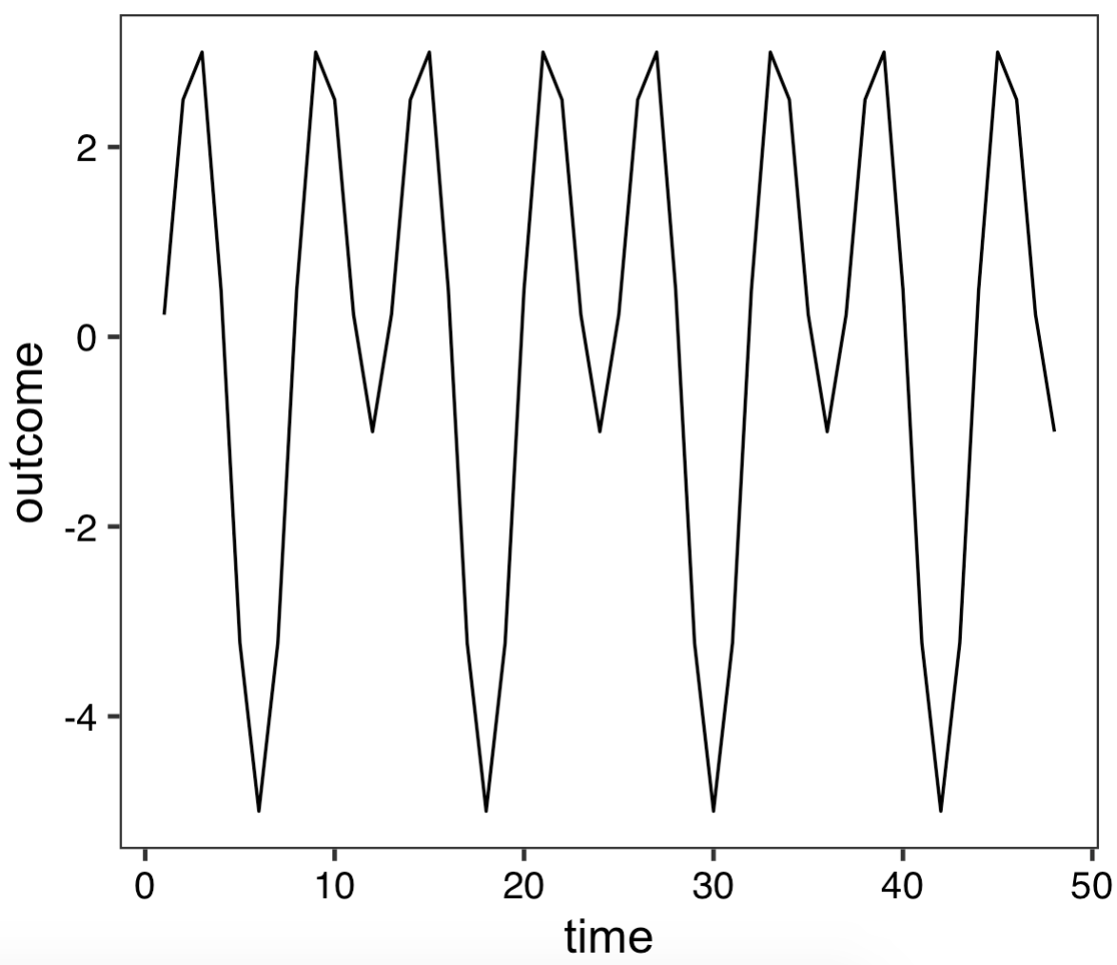
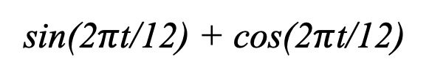
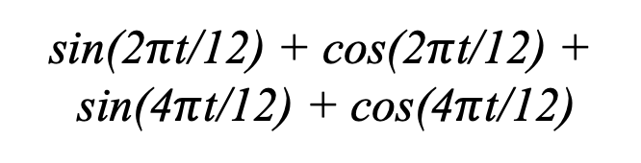
Fourier series (examples)
sin(2$π$t/12) + cos(2$π$t/12) +
sin(4$π$t/12) + cos(4$π$t/12)
sin(2$π$t/12) + cos(2$π$t/12)

Slide 43
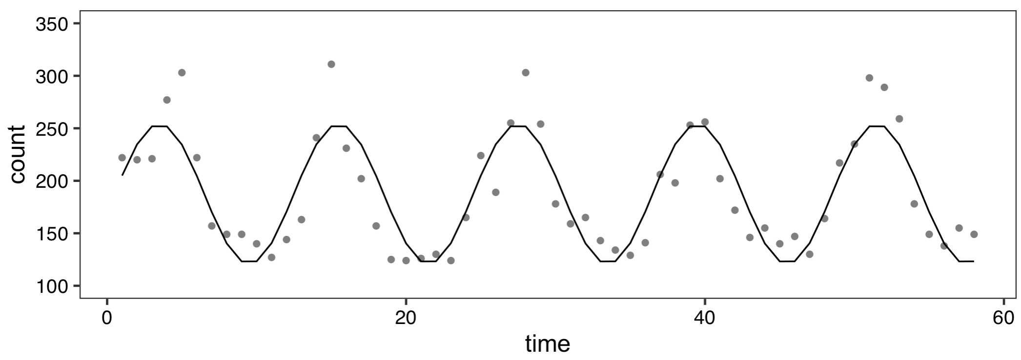
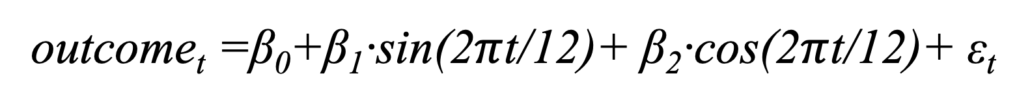
Malaria cases in Malawi facility
outcome_{t} =β₀+β₁·sin(2$π$t/12)+ β₂·cos(2$π$t/12)+ ε_{t}

Slide 44
Extra Slides

Slide 45
Step 4: Autocorrelation

Slide 46
What is autocorrelation?
Relationship in data points over time
Means the data points are not independent
Two types we will discuss:
Autoregression
Moving Average

Slide 47
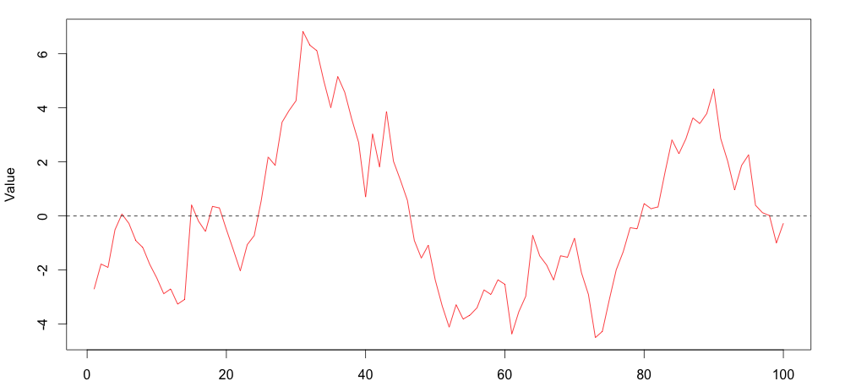
Autoregression
Notes:
Autoregressive (1)
Phi is the parameter, upsilon represents remaining error term
Regression error of each point is related to the one before it

Slide 48
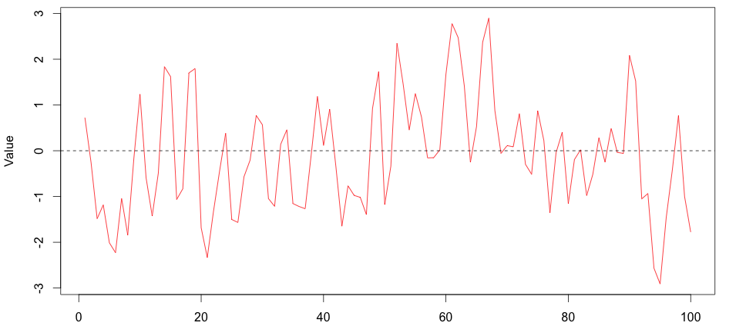
Moving Average
Notes:
Moving Average (1)
upsilon represents error term and previous error term, theta is relationship
Size of the random shock is related to the one before it

Slide 49
Methods to Check Autocorrelation
Several methods, including:
Durbin-Watson test
Residual plots
ACF and partial-ACF plots

Slide 50
Durbin-Watson test
A formal test that tests for correlated residuals
Interpretation
Values of 2 indicate no autocorrelation
lower values indicate positive correlation, higher indicates negative correlation
# Durbin-watson test, 8 time periods
dwt(ols.model.time2,max.lag=8,alternative="two.sided")

Slide 51
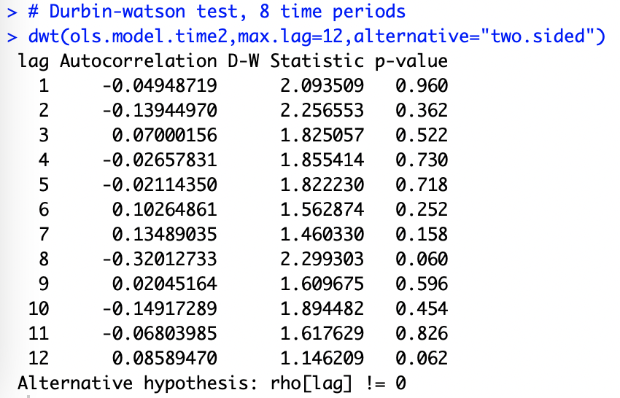

Slide 52
Residual plot
Use a residual plot to visually inspect for independence
ggplot(dataset,aes(x=time,y=ols.model.time2$residuals)) +
# Add points
geom_point(color="red") +
# Add fitted line
geom_line(color="red") +
# Add horizontal line through zero
geom_hline(yintercept=0,linetype="dashed") +
# Change figure aesthetics
xlab("Time") +
ylab("OLS Residuals") +
theme_bw()

Slide 54
Autocorrelation plots
A plotting method with which you can assess autocorrelation and moving averages
Two plots
Autocorrelation
Partial autocorrelation
Notes:
ACF: correlation of a variable with itself over time
PACF: correlation of a variable with itself after removing linear dependance

Slide 55
Model | ACF | Partial ACF
No autocorrelation | All zeros | All zeros
Autoregressive (p) | Exponential Decay | p significant lags before dropping to zero
Moving Average (q) | q significant lags before dropping to zero | Exponential Decay
Both (p,q) | Decay after q^{th} lag | Decay after p^{th} lag

Slide 56
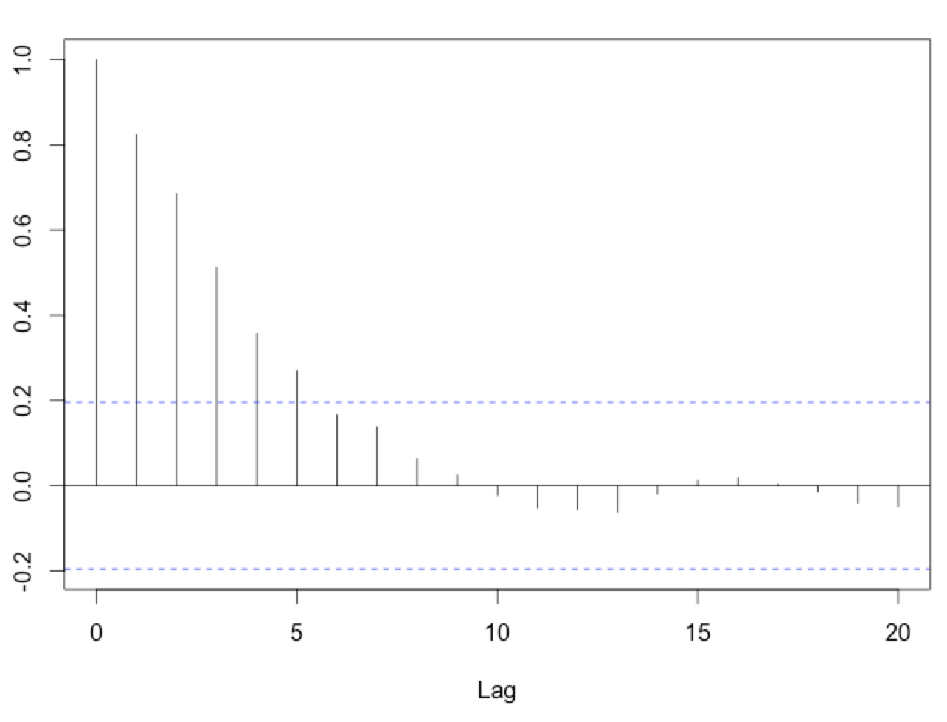
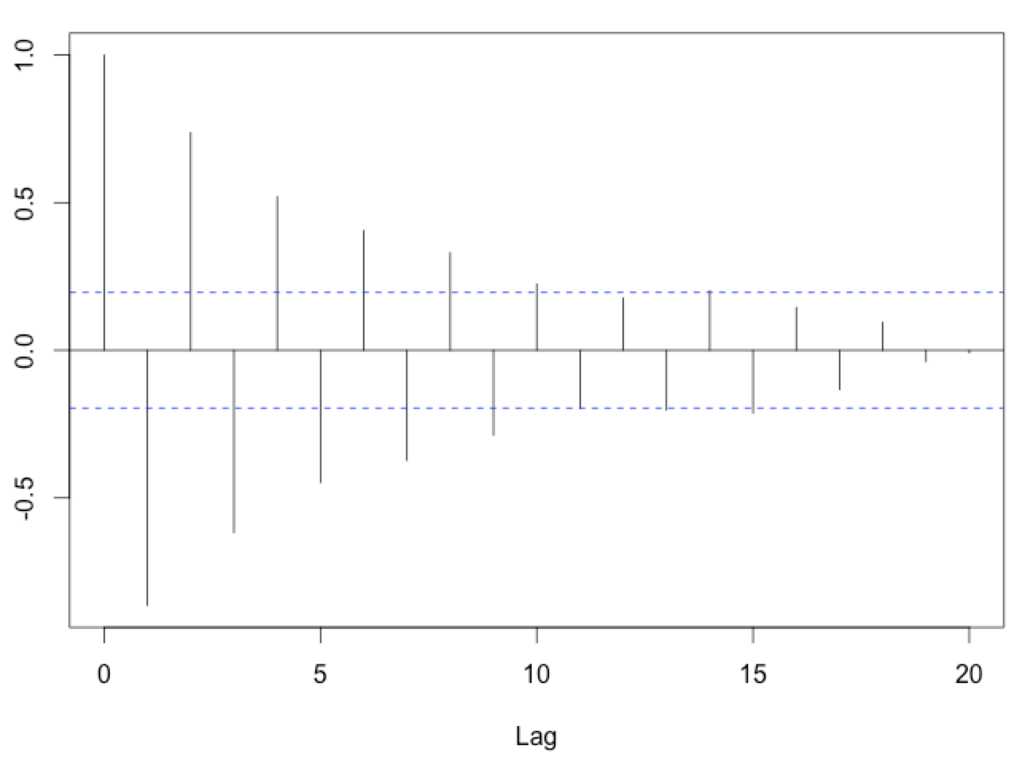
Examples of Exponential Decay

Slide 57
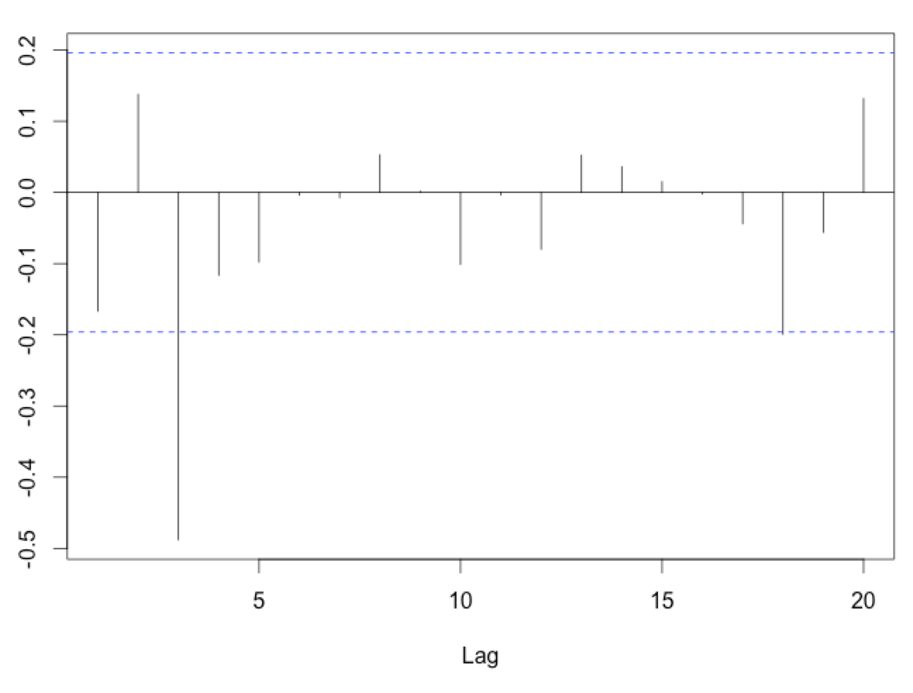
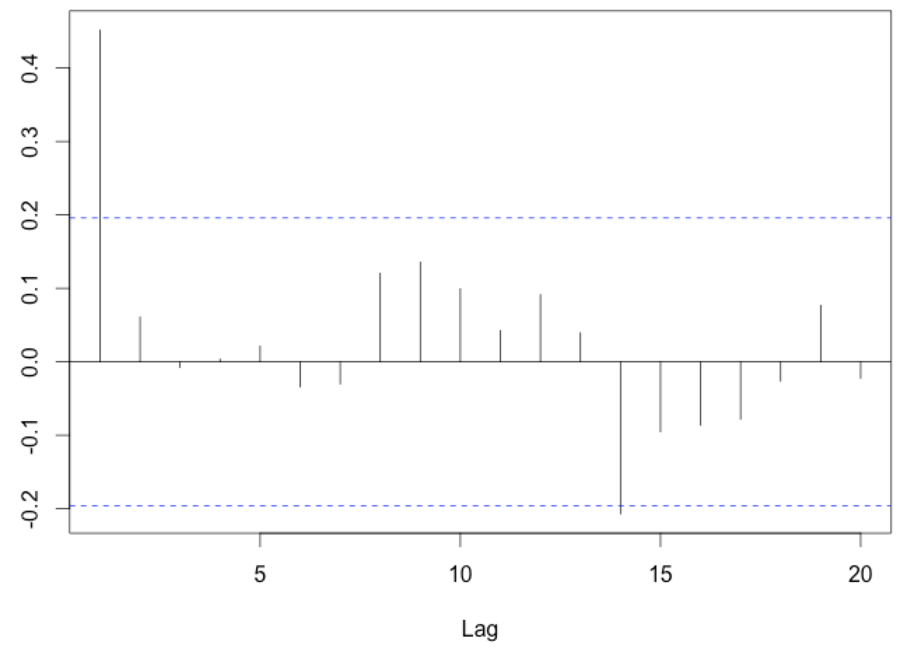
Examples of Significant Lags

Slide 58
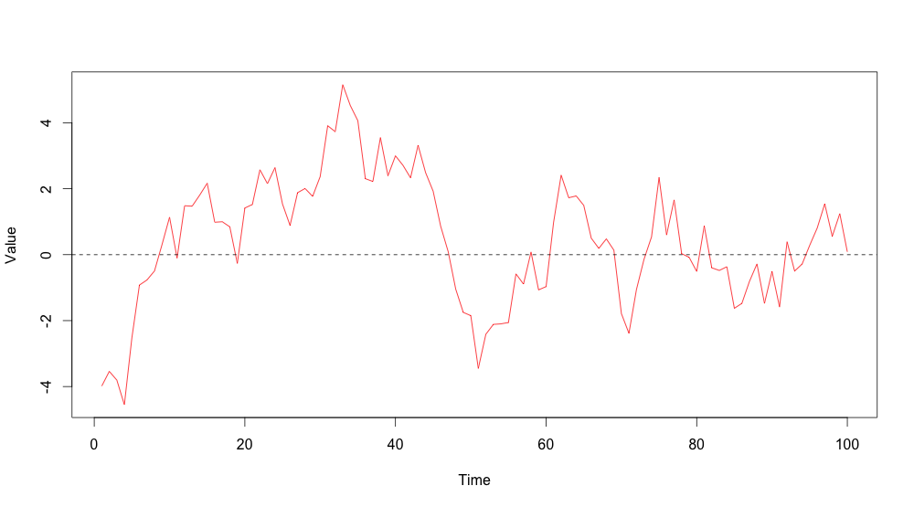
Notes:
Autoregressive (1)
Phi is the parameter, upsilon represents remaining error term

Slide 59
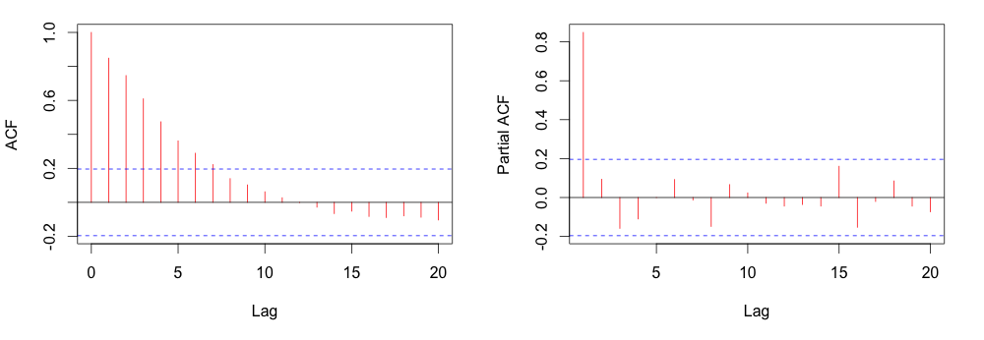
Notes:
Exponential decay on ACF, spike at 1 on PACF
Conclude AR(1) process for modeling

Slide 60
Model | ACF | Partial ACF
No autocorrelation | All zeros | All zeros
Autoregressive (p) | Exponential Decay | p significant lags before dropping to zero
Moving Average (q) | q significant lags before dropping to zero | Exponential Decay
Both (p,q) | Decay after q^{th} lag | Decay after p^{th} lag

Slide 61
Producing ACF/PACF plots
# Plot ACF and PACF
# Set plotting to two records on one page
par(mfrow=c(1,2))
# Produce plots
acf(residuals(ols.model.time2),main="ACF")
acf(residuals(ols.model.time2),type='partial',main="PACF")
# Reset the plotting
par(mfrow=c(1,1))

Slide 62
Notes:
Note the 8 on the right—consistent with the DWT

Slide 63
Step 5: Run the Final Model

Slide 64
Where we are now
Setup data
Visually inspect the data
Preliminary analysis
Check for and address autocorrelation
Run the final model and plot the results

Slide 65
Running the final model
Use function gls (similar specification to lm)
If we wanted to use AR(1), for example:
# Fit the GLS regression model with AR(1)
model_final <- gls(count ~ time + time2,
data=dataset,
correlation=corARMA(p=1,form=~time),
method="ML")
summary(model_final)

Slide 66
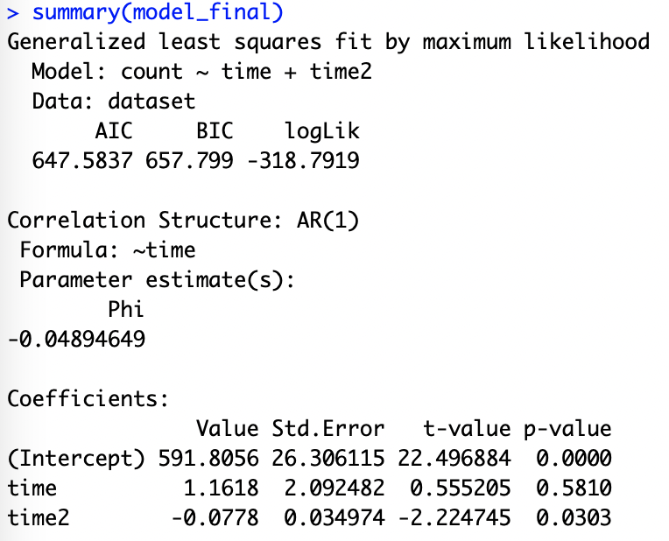

Slide 68
Next week...
Seasonality
Predictions
Syndromic surveillance models

